Slide 1








Aziz
Emil
Jorge
Pedro
Walid
Fifa Metrics FC
Sponsored by:

Slide 2
Mission Statement:
Analyze how player attributes can shape their overall value in the market.
Analyze how FIFA rates their players, clubs and countries.

Slide 3
Questions:
What are the top 10 players with highest growth potential?
What are the top 10 Nations & top 10 Clubs based on Player Value?
How do positions/wages/overall ratings vary in each league?
What is the relationship between market value, wage and overall performance?
What is the relation between player height and their overall ratings?

Slide 4
Dataset:
FIFA 19 Dataset from Kaggle
89 columns of attributes for each player
Shooting, Defending, Passing, Wages etc
Data generated from https://sofifa.com

Slide 5
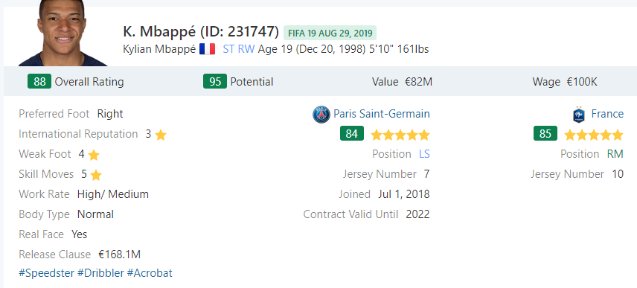
Example of Data:

Slide 6
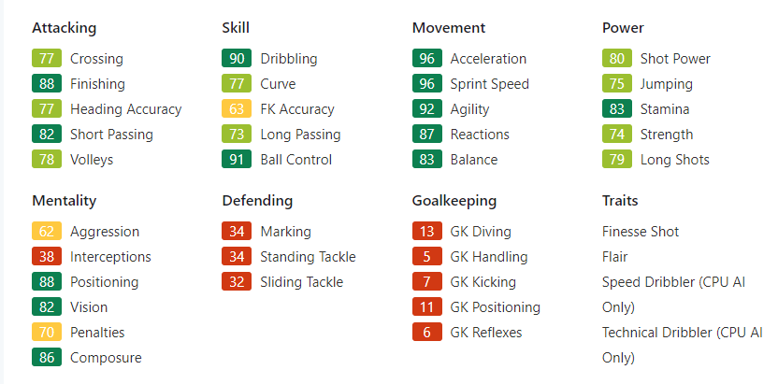
Example of Data:

Slide 7
Data Cleaning: Numeric Values
Adjusting Wage, Value and Release Clause columns to numeric fields
€226.5 M to 226500000.00
€170.5 K to 170500.00

Slide 8
Data Cleaning: Simplified Position
Combining all of the positions into 4 simplified positions
Goalkeeper: GK
Defender: LWB, RWB, LB, LCB, CB, RCB, RB
Midfielder: LAM, CAM, RAM, LM, LCM, CM, RCM, RM, LDM, CDM, RDM
Attacker: LS, ST, RS, LW, LF, CF, RF, RW
Added new column to DataFrame called “Simplified Position”

Slide 9
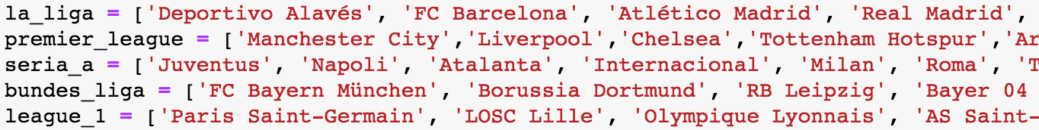
Data Cleaning: Creating Leagues
Placed all club teams in their respective leagues
Added a new column to the DataFrame called “League”

Slide 10
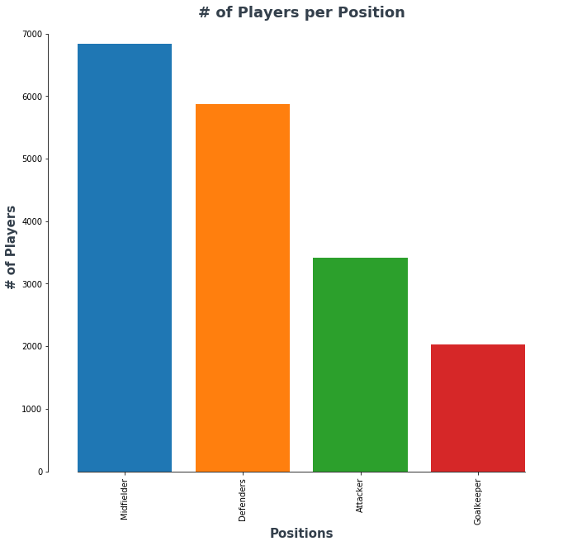
Players per Position

Slide 11
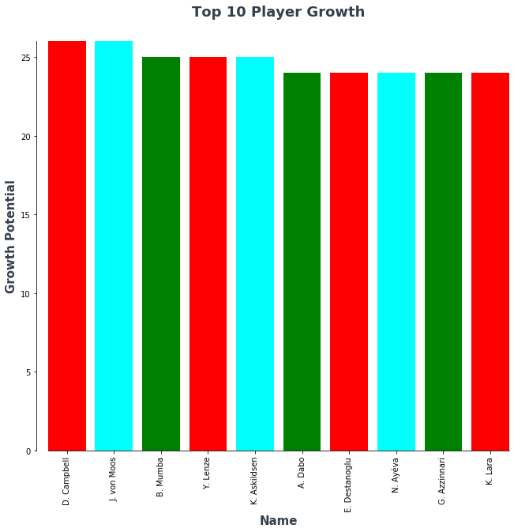
Top 10 Player Growth

Slide 12
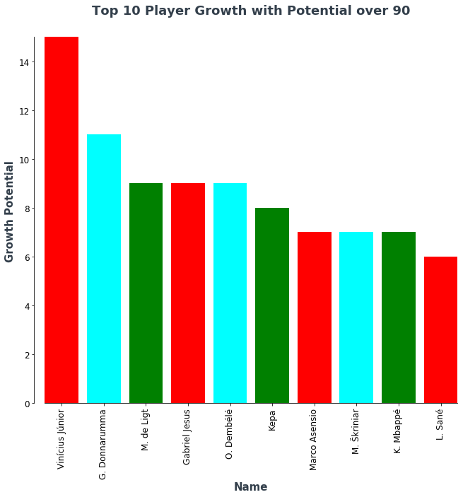
Top 10 Player Growth with Potential over 90

Slide 13
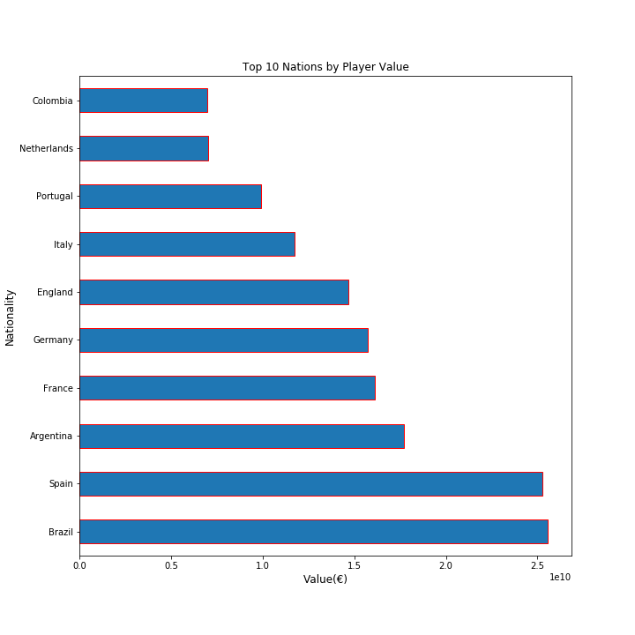
Top 10 Nations by Player Value(€)
Nationality | Value(€)
Brazil | € 25,574,675,000.00
Spain | € 25,252,050,000.00
Argentina | € 17,707,960,000.00
France | € 16,128,955,000.00
Germany | € 15,738,110,000.00
England | € 14,670,615,000.00
Italy | € 11,730,695,000.00

Slide 14
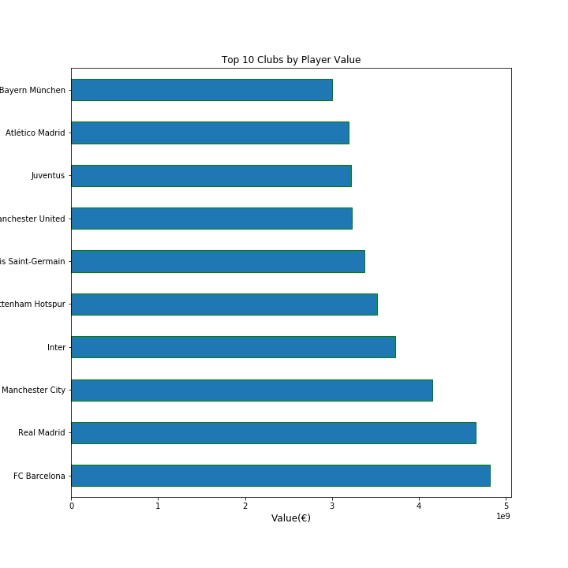
Top 10 Clubs by Player Value(€)
Club | Value(€)
FC Barcelona | € 4,819,800,000.00
Real Madrid | € 4,654,425,000.00
Manchester City | € 4,149,855,000.00
Inter | € 3,730,785,000.00
Tottenham Hotspur | € 3,522,750,000.00

Slide 15
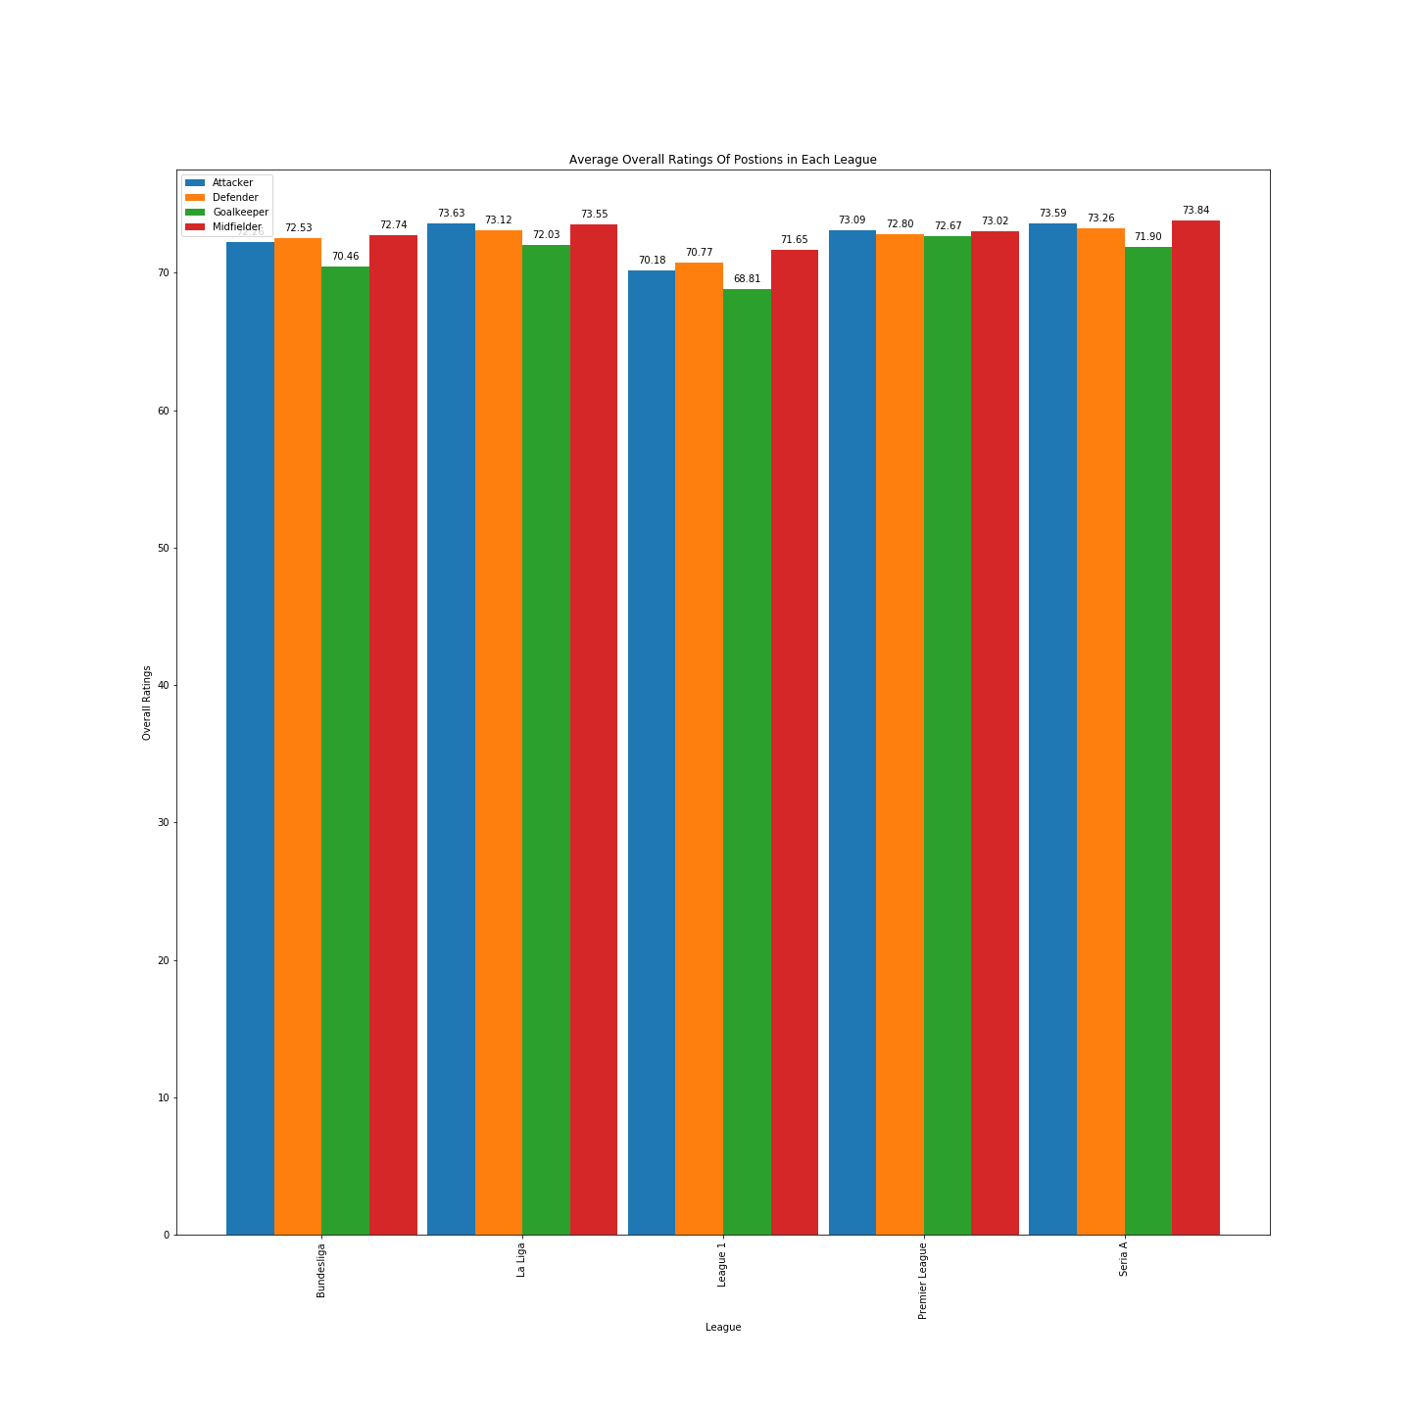

Slide 16
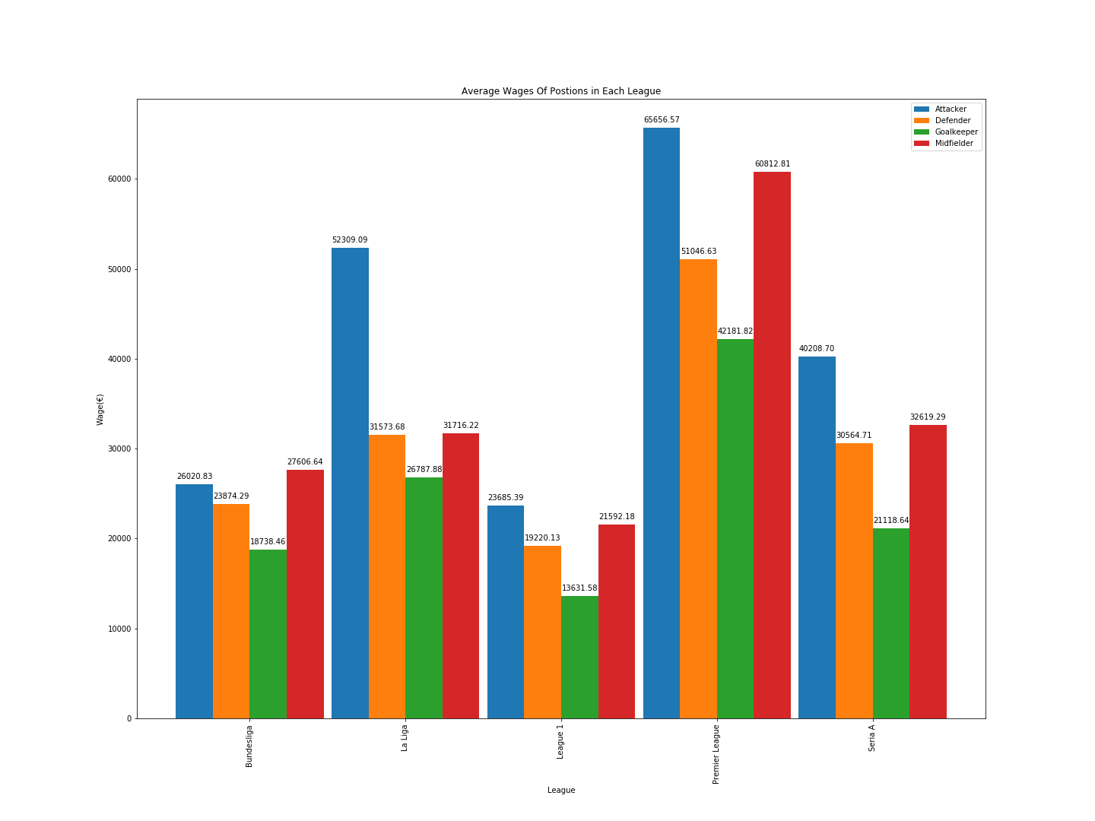
Data cleaning
We also were able to change remove the “M” “K

Slide 17
Pedro - Player’s market Value, Wage and Overall Performance
What is the relationship between market value, wage and overall performance?

Slide 18
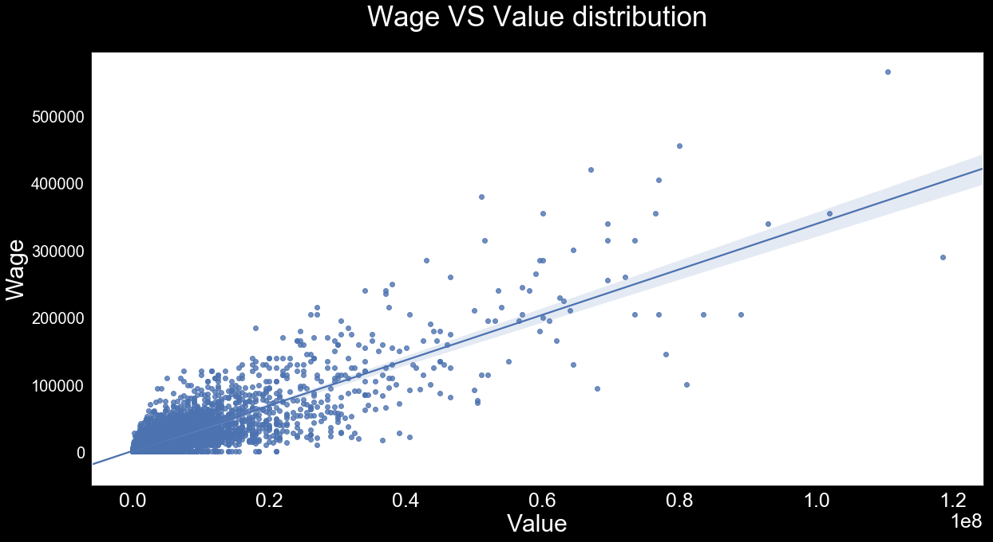

Slide 19
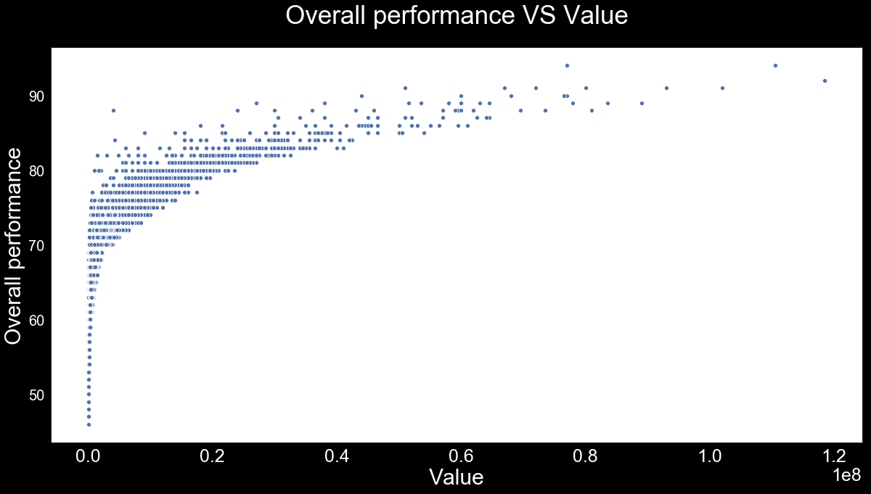

Slide 20
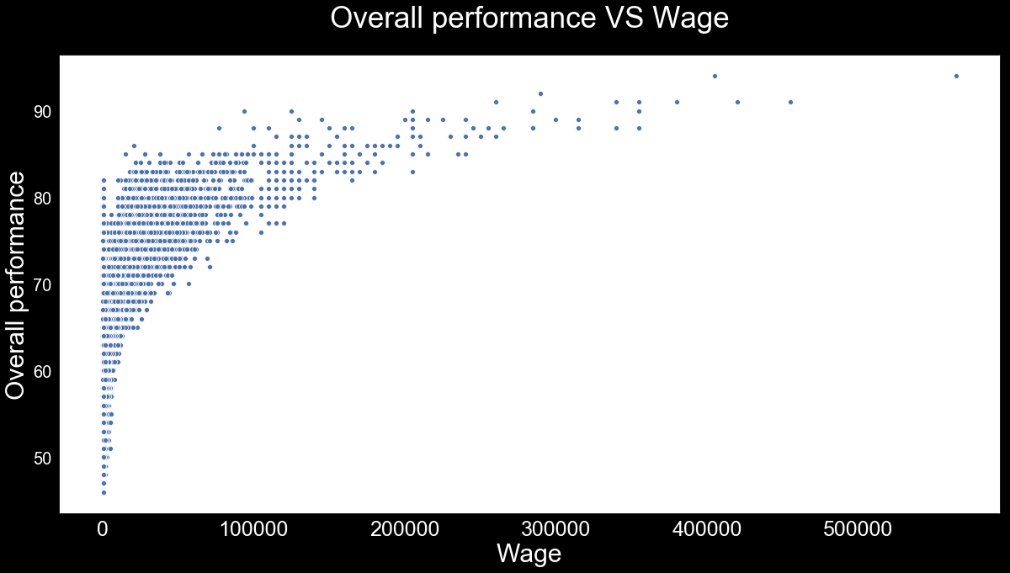

Slide 21
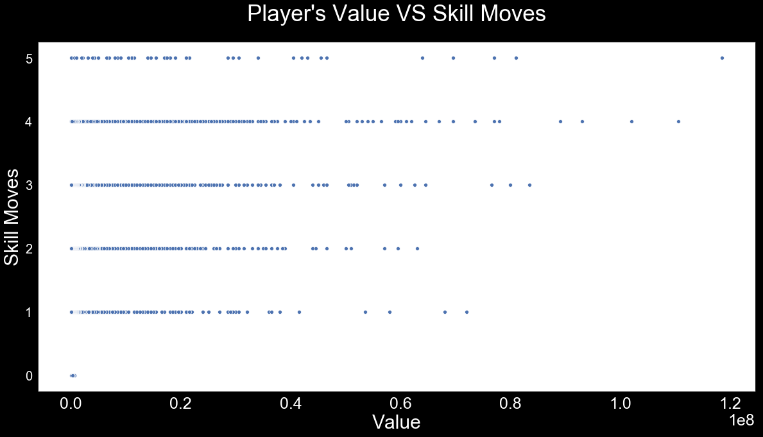

Slide 22
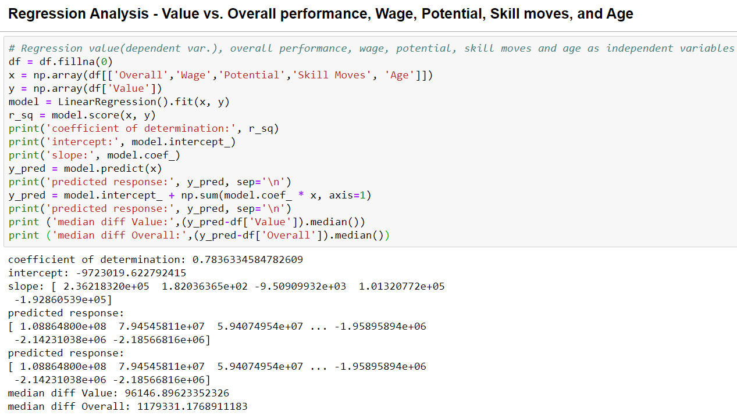

Slide 23
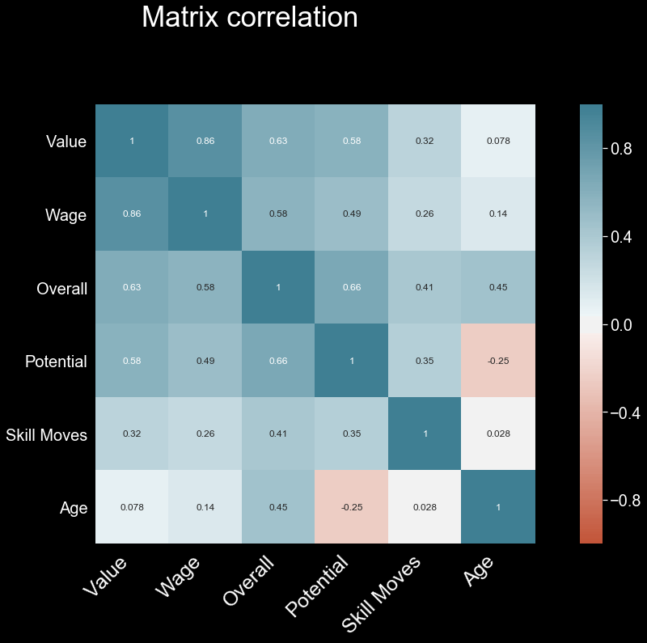

Slide 24

Does FIFA strongly use height to a player’s overall rating?
The player on the right is taller, is he valued more in the world of FIFA?

Slide 25
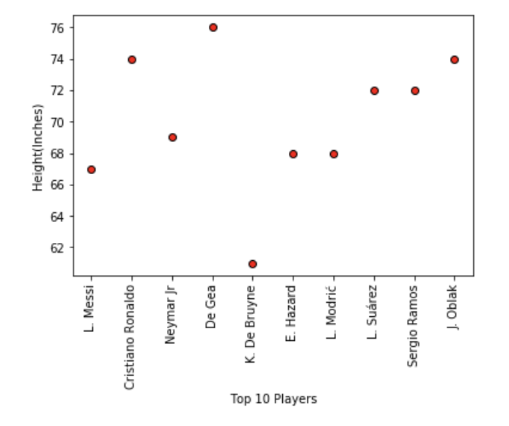
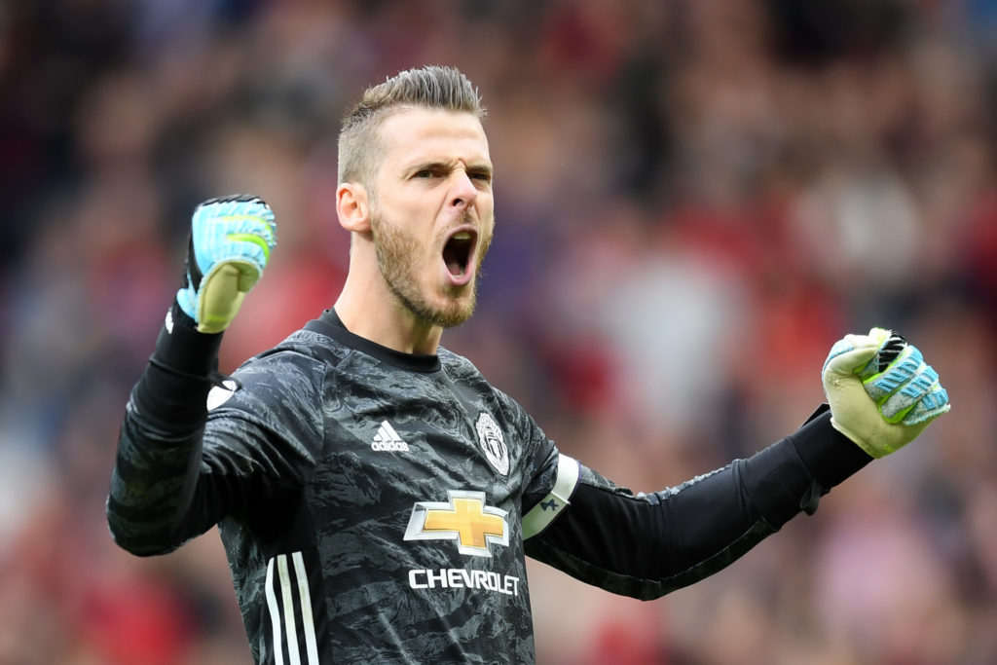
The best players in the world vs height
David DeGea, best rated tallest player is
a goalkeeper.
Only players in soccer allowed to use their hands
Rating increases

Slide 26
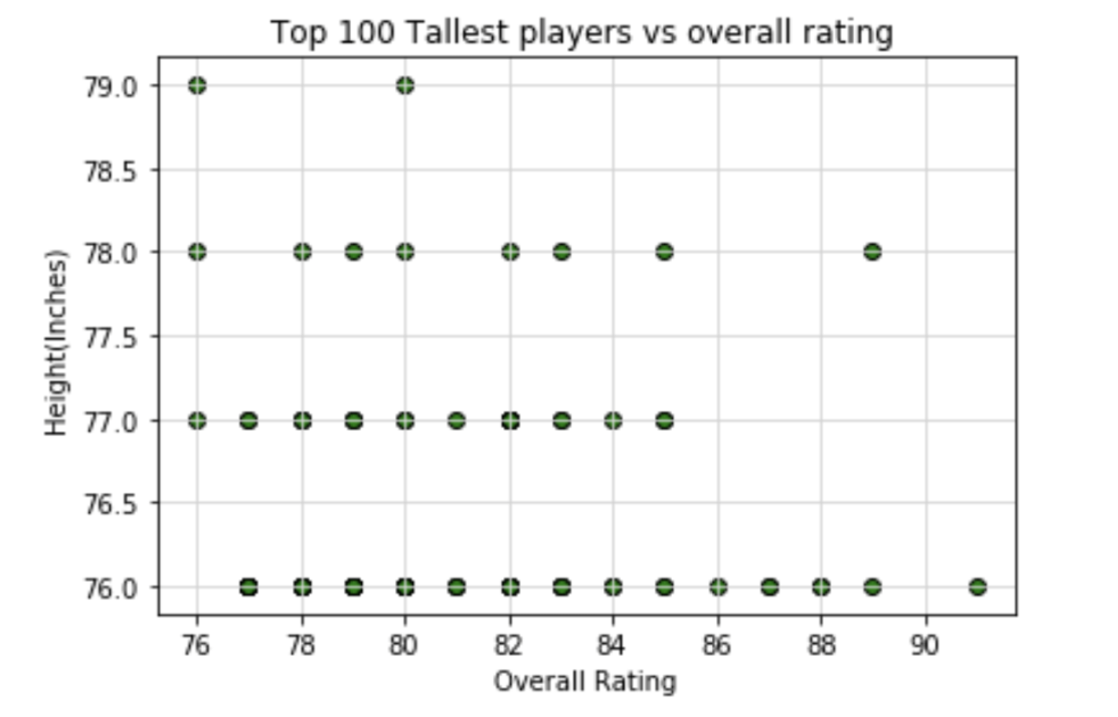
The Tallest 100 players and their rating

Slide 27
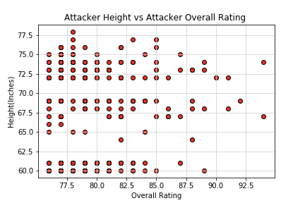
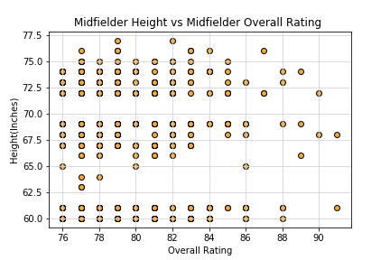

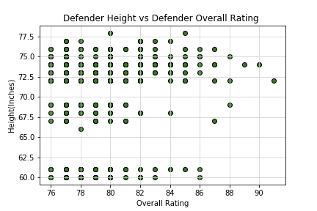
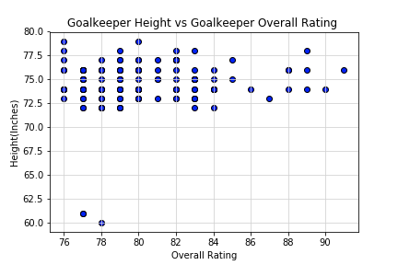
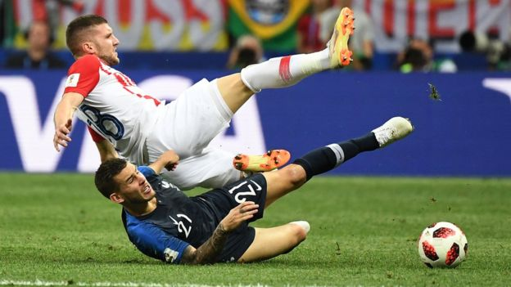

Player Positions Height vs Rating

Slide 28
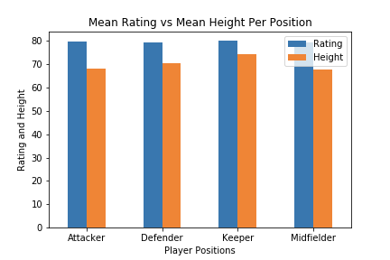
Looking at goalkeepers closely

Slide 29
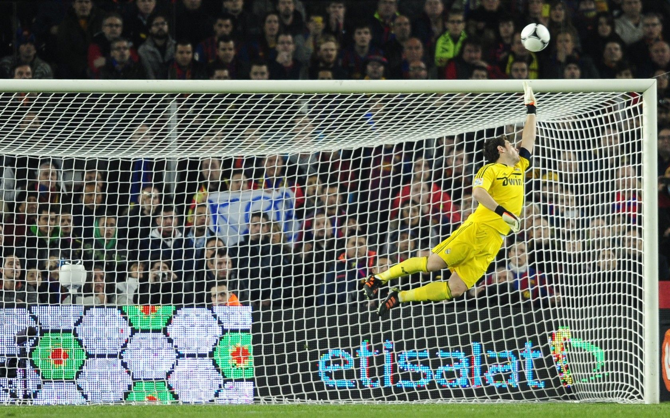
Height is important for a goalkeeper in football, best rated
are taller .

Slide 30
Limitations:
Data only focused on 2018-19 player data
Data did not contain columns for leagues so we only focused on top 5 leagues in top 5 leagues

Slide 31
Summary:
D. Campbell and J. Von Moos will see the most overall improvement.
Vinicius Junior has the most potential to be the next superstar.
There is high correlation between value and wages. Medium correlation between overall performances, potencial and financial returns. Low to negative correlation among skill moves, age and financial metrics.
Players positions & wages in each league does not affect their overall ratings.
A clubs value does not correlate to a players rating or wages.
South America outperformed in talent by nation based on player value however the highest player value at the club level came from Europe.
A player’s overall rating is not evidently affected by their own height, unless you are a goalkeeper playing on the world stage!

Slide 32
Thank you!

